Slide 1
This cell is in a solution. Is the solution hypo/hyper/iso tonic? Which direction will water move? Explain.

Slide 2
“Party Preparations”
Write the guiding question on a new page

Slide 4
M.V.-
R.V.-
C.V.-

Slide 5
“Celery Sucks”
Write the guiding question on a new page

Slide 6
Background

Slide 7
What are the 3 basic types of cells found in plants? Describe them.

Slide 8
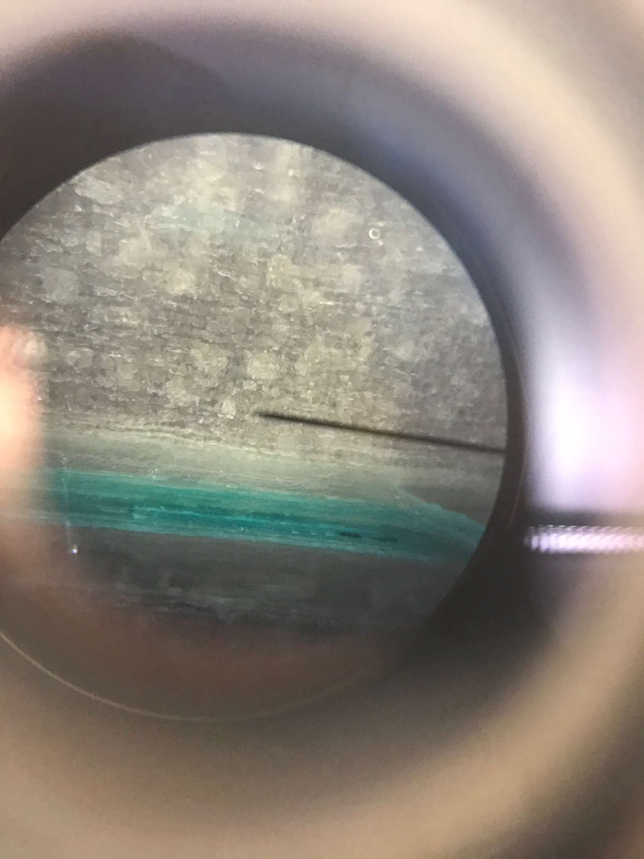

Slide 9
Parenchyma
Thin cell walls
Large central vacuole

Slide 10
Collenchyma
Smaller than parenchyma
Thin cell wall in the middle, but corners are thickened

Slide 11
Sclerenchyma (fibers)
Long cells with thick secondary cell walls (in pink)
Egyptians used to make rope, papyrus

Slide 12
How does water move through plants? How does salt affect bending? What have you learned from the labs that will help you answer these 2 questions?

Slide 13
Analysis
Using your background notes and your lab observations, explain why water was only sucked up by certain areas on the celery stalk.
Science content to include: transpiration, osmosis, xylem, parenchyma, collenchyma, sclerenchyma fibers
Using your background notes and your lab observations, explain which salt concentration produced the most bending in your celery and why.
Science content to include: transpiration, osmosis, hypo, hyper, iso tonic, turgor pressure.
Write down at least 5 questions related to the changes you have observed. At least one question should relate to quantitative data and at least one question should relate to qualitative data.

